Slide 1
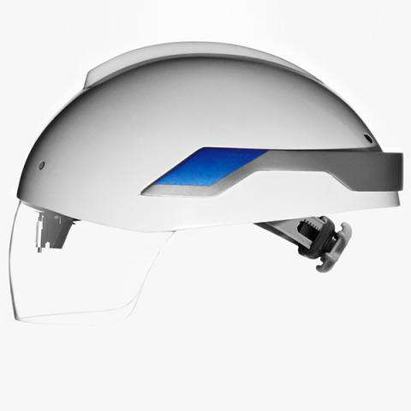
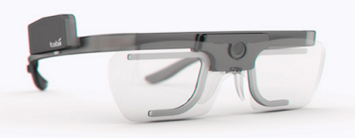
Peer to Peer Stack
Improved Performance
Optimal Equipment Separation
Action
Decision Mediation
Driver Alerts
Situation Awareness
Collision Avoidance
Three Sixty Protocol
Network Layer

